Slide 1
Functional Coordinator/Service Representative
Introduction Training
March 2013

Slide 2
Agenda
Introduction
What does a Functional Coordinator/Service Representative (FC/SR) do?
Training
Working with BDR
FC/SR Resources
Pegasys Recertification
Access Forms
Typical Activities

Slide 3
Introduction

Slide 4
FC/SRs play a key role in assisting BDR deliver
great customer service to Pegasys users throughout GSA
In 1999, after much discussion with General Services Administration (GSA) leadership,
it became apparent that each region needed a FC/SR to assist daily Pegasys users throughout GSA
While there was other Pegasys support available at the time, there was still a need for an initial point of contact in each region for functional and day-to-day questions
Today, FC/SRs play a very important role with OCFO/BD and Pegasys users. BDR views FC/SRs as “cheerleaders” and “champions” of BDR’s mission of supplying excellent customer service to all Pegasys users throughout GSA
FC/SRs allow BDR to maximize its customer service by taking a “regional” approach to helping users solve issues and learn new procedures within Pegasys
  SRs fill the same role as FCs but assist users in the Central Office
  SRs have the authority to make Service-related decisions regarding Pegasys

Slide 5
What does a FC/SR do?

Slide 6
FC/SRs have a variety of duties and responsibilities
Assist users with obtaining access to Pegasys, and ensure the roles and approval types provided are not in violation of the separation of duties policies
Address questions and issues related to the Pegasys system
Encourage Pegasys users to recertify during the recertification period
Reinforce OCFO communications to users about system upgrades, procedure changes, issues, user tips or any other information the Customer Service Division (BDR) needs to disseminate to the user base
Monitor the use of Pegasys in the central, region, and field offices, and communicate successes, improvements needed, and/or other BDR requests
Interact with other regional and field office employees that use Pegasys as part of their daily work functions, such as finance personnel and others on the Pegasys team.
Ensure that Pegasys users have access to training resources. As desired, FCs may directly provide training to Pegasys users. Examples of this include leading group training, providing one on one training, and coordinating with Central Office to provide training via site visits or Webex. Additionally, each FC may develop regional handouts to supplement those distributed from the Central Office
Assist Pegasys users with the recertification process; however, users are ultimately responsible for ensuring that they are properly recertified
Process User ID forms for Pegasys users

Slide 7
Training

Slide 8
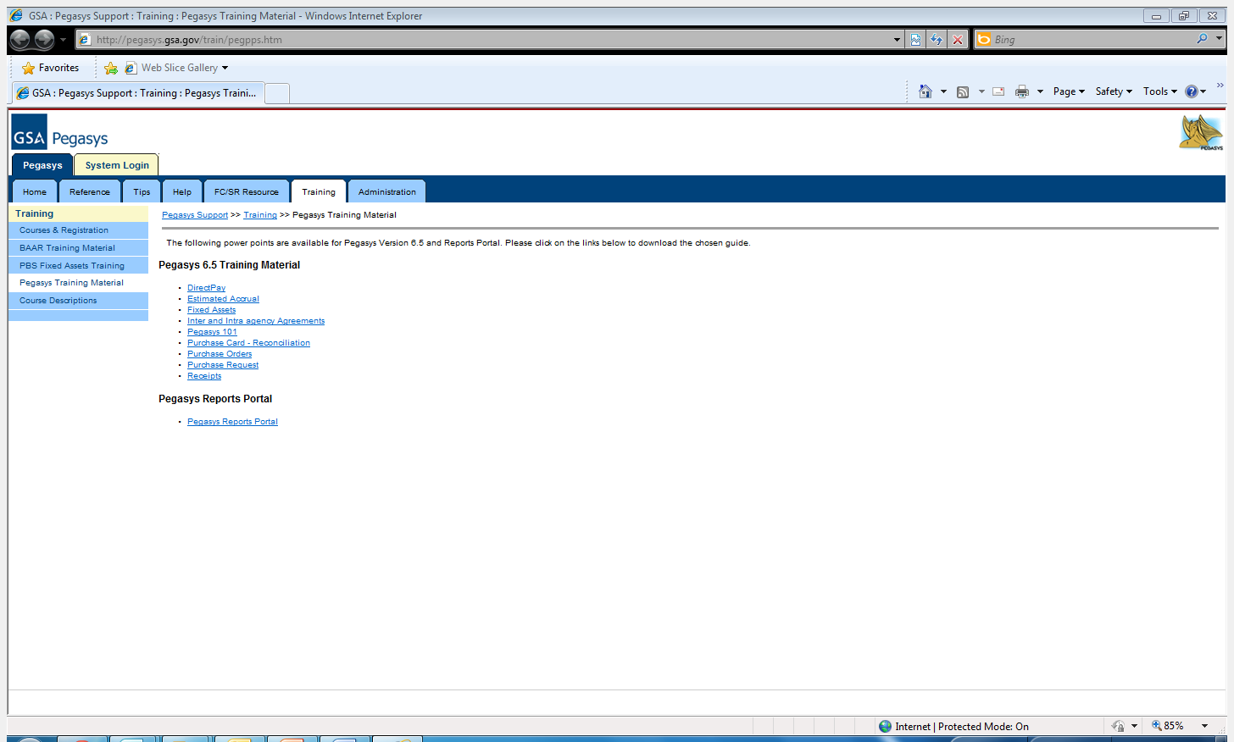
Pegasys.gsa.gov has many types of training that will help FC/SRs assist users with training
Located at http://pegasys.gsa.gov/train/pegpps.htm are the training materials that each new FC/SR should review before assuming duties
Pegasys training through WebEx is also offered through the Courses & Registration link
FC/SRs should take note of Pegasys 101, which provides training for all new Pegasys users

Slide 9
FC/SRs serve Pegasys users in their region by providing or facilitating training
Each region operates differently and, as such, each FC may approach user training differently.
At a minimum, FCs are responsible for ensuring that Pegasys users have access to training resources.
As desired, FCs may directly provide training to Pegasys users. Examples of this include leading group training, providing one on one training, and coordinating with Central Office to provide training via site visits or Webex.
Each FC may develop regional handouts to supplement those distributed from the Central Office.Members of the Pegasys team in Central Office are also available to provide training sessions to Pegasys users in the region
Please contact the BD Functional Coordinator Lead if you would like to have someone come in and teach training sessions to your users

Slide 10
Working with BDR

Slide 11
BDR will support FC/SRs in providing customer service to Pegasys users
FC/SRs will be required to call into periodic meetings held by the BD Functional Coordinator Lead
    Meetings will include an update on Pegasys issues
    FC/SRs are invited to bring their concerns and questions
    BDR also wants to know what issues central and regional users might be having with Pegasys
  BDR will also be sending FC/SRs information and other materials about upgrades, system changes and other issues first before sending this information to all Pegasys users
  BDR views FC/SRs as a part of the team
  Don’t hesitate to reach out to the BDR Functional Coordinator Lead with any issues

Slide 12
FC/SR Resources

Slide 13
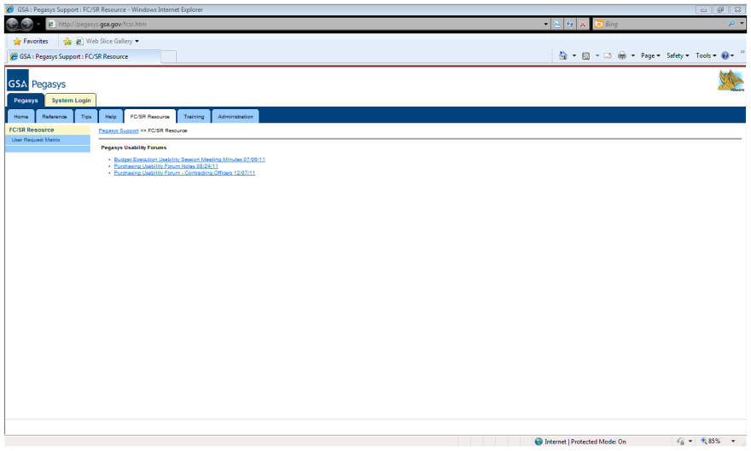
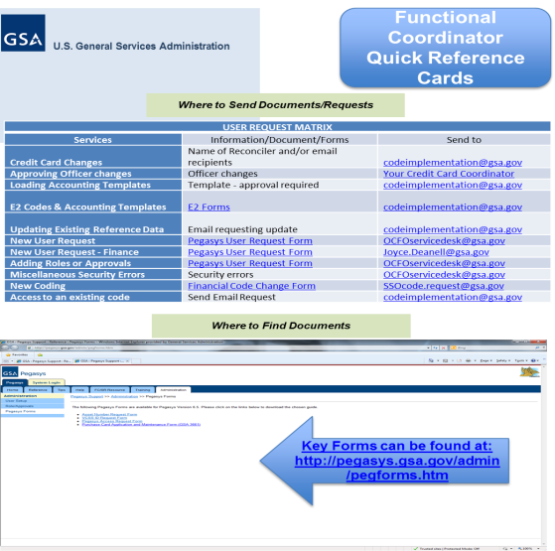
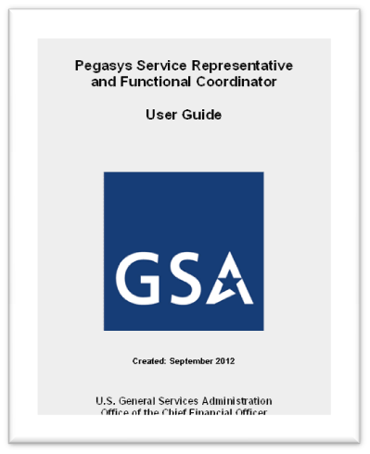
Online and printable resources are available to support FC/SRs
The FC/SR section on Pegasys.gsa.gov contains lots of valuable information for FC/SRs
FC/SRs can locate Quick Reference Cards here that can be printed out and serve as daily reference guides
The Pegasys Functional Coordinator User Guide is also located here. It is comprehensive and contains many tips on daily FC/SR duties

Slide 14
Pegasys Recertification

Slide 15
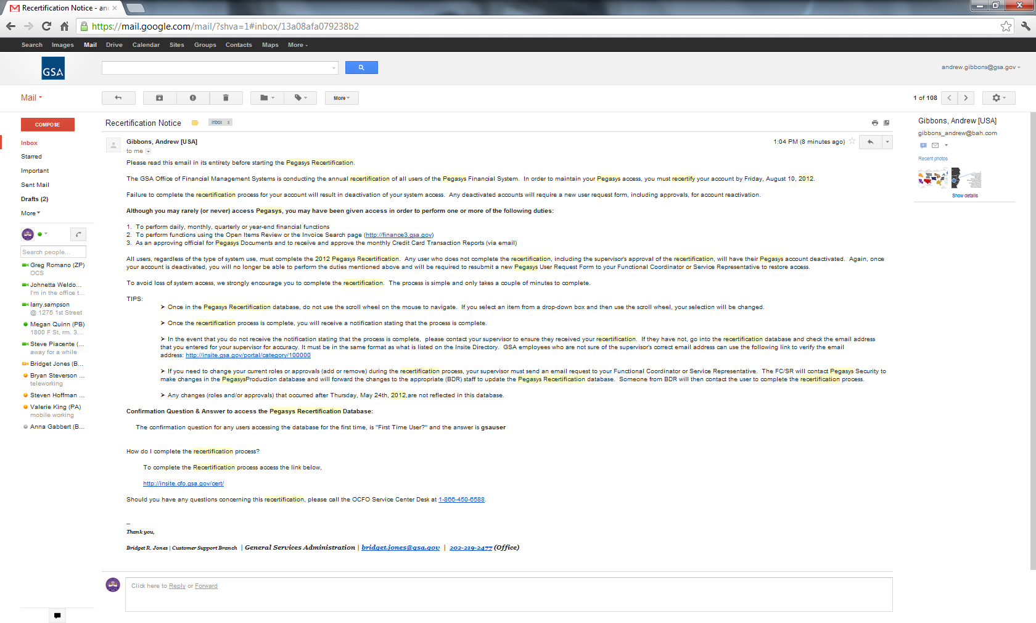
FC/SRs assist BDR with Pegasys users recertification
Recertification of all Pegasys users is performed between May and June on an annual basis by BDR
Recertification is done to both ensure that all users maintain Pegasys access and to identify any changes to an account that may have been overlooked during the year
FC/SRs play a key part in supporting any changes needed to a user’s roles, approval types, and security organizations
FC/SRs should consult the User Guide for more in-depth instructions for how to handle the recertification period
Example of
Recertification Memo
The recertification process
must be completed
in its
entirety by June 30th

Slide 16
Access Forms

Slide 17
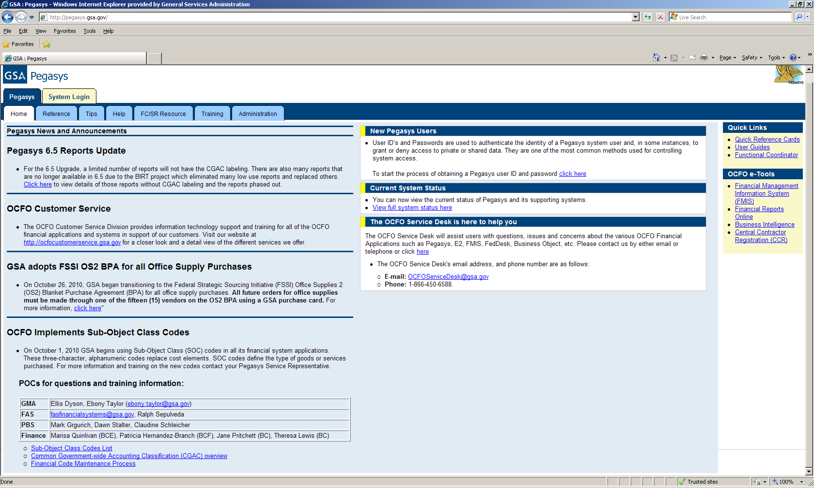
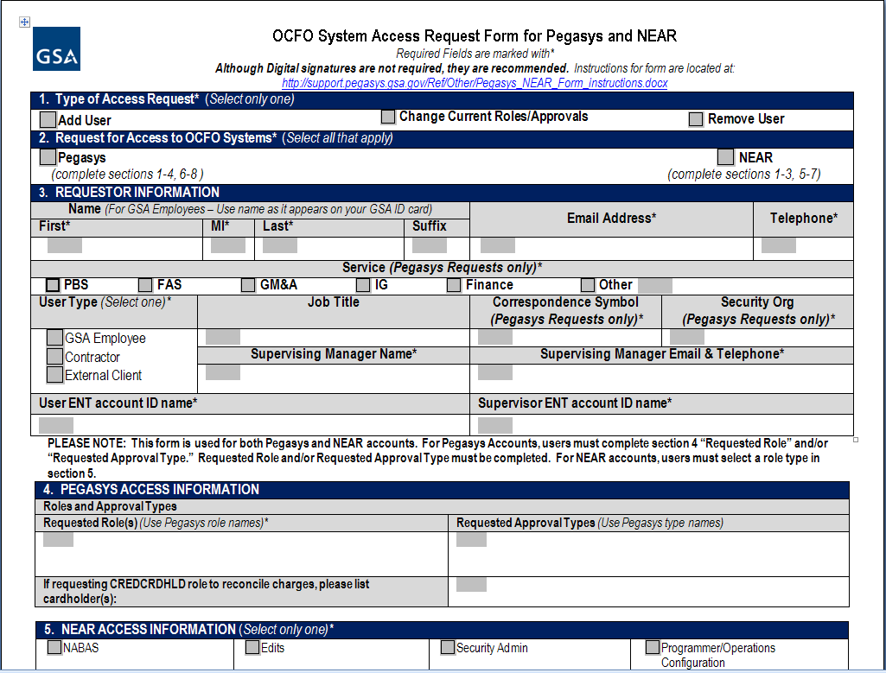
FC/SRs should assist new Pegasys users
Pegasys Access Request Forms are located at http://pegasys.gsa.gov/admin/pegforms.htm
FC/SRs should help their users fill out this form. For questions, see the instructions.

Slide 18
Typical Activities for FC/SRs

Slide 19
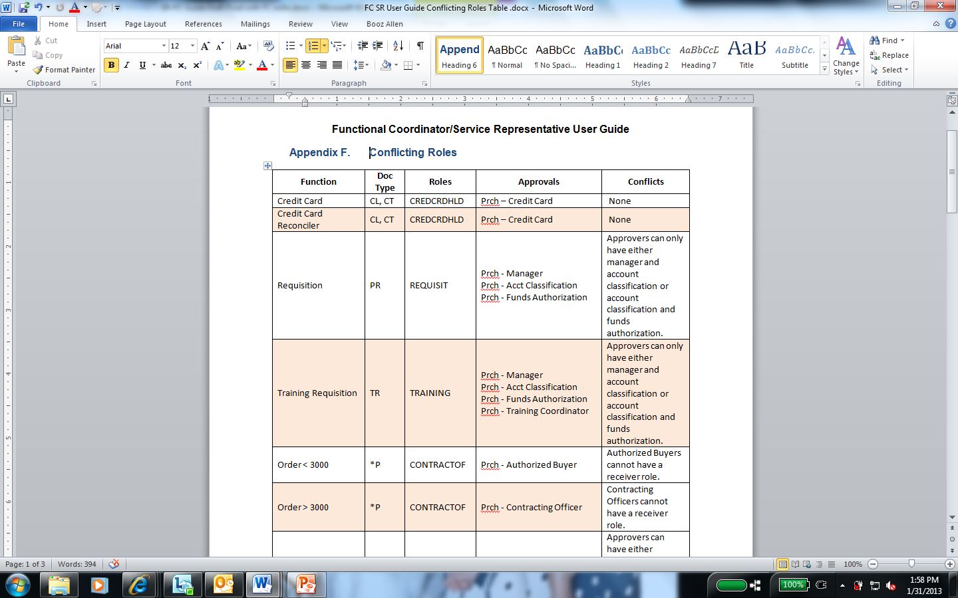
FC/SRs play a key part in managing a user’s roles and approvals
FC/SRs help their users manage their Pegasys roles and approvals. To determine which roles and approval types are needed, two questions need to be posed to the Pegasys user?
  1) What job functions do you typically perform?
  2) What documents do you typically use?
Essentially, roles and approval types determine the functions a user can perform within the Pegasys system
It should be noted that roles can conflict and users are not allowed to have roles that could negatively affect the procurement lifecycle process. See Appendix F of the User Guide for more information on conflicts.

Slide 20
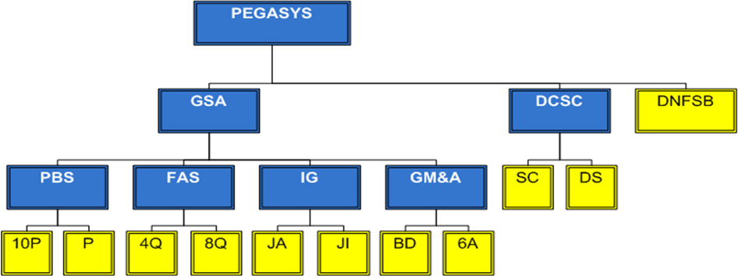
FC/SRs must have an understanding on how Security Organizations affect Pegasys input
Security Organizations define what Pegasys data users can input, update, or view
A Security Organization allows users and data to be put into logical groups that have order and establish clear lines of organizational structure
Users can be assigned to more than one Security Organization, depending on their job or role, but data is always assigned to just one Security Organization to help track and organize the data. A user can only access data within the Security Organization(s) to which they belong
A person under 10P has access to 10P documents
and could have access to other documents within
PBS, GSA, and Pegasys. However, they would not
have access to P or access to FAS or other reference
data not in their line unless they are granted it in a
separate Security Organization.

Slide 21
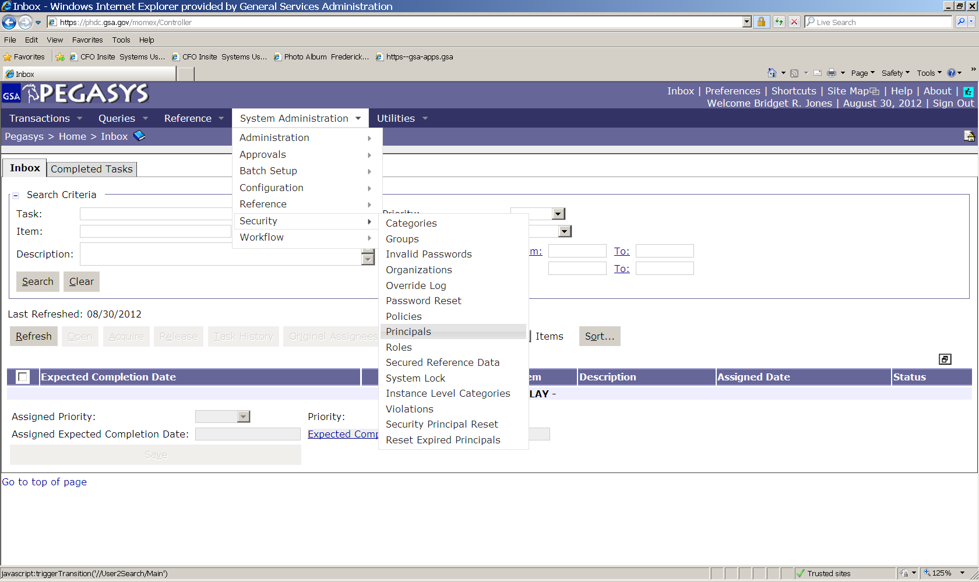
The Principals Table shows FC/SRs the latest information on their Pegasys users
From the Principals Table, FC/SRs can learn three key things about a user’s access:
  Whether a user’s access is active or inactive
  Whether the user’s access has been removed, and if so, the reason for the removal
  The Security Organization(s) and Roles/Approvals assigned to that specific user
To get to the Principals table, click on System Administration tab→ then Principals tab
More Information on the Principals
Table can be found starting on Page 8 in
the User Guide

Slide 22
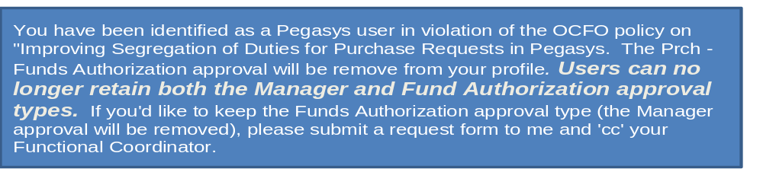
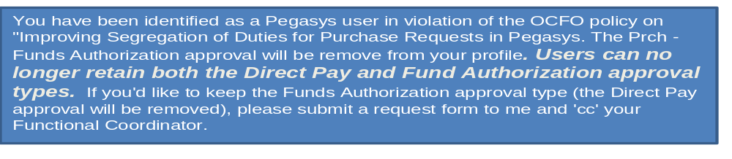
Many user roles within Pegasys can conflict with other user roles and this is not allowed because it could negatively affect the procurement lifecycle process
Examples of conflicting roles and approval types can be found in Appendix F of the User Guide
Users in violation can be sent emails like the two examples presented below if they are violating the role rules
If you have any questions about managing roles or approvals, FC/SRs and/or users can contact Joyce Deanell (BDAC) at Joyce.Deanell@gsa.gov or at 202-501-4836

